Slide 1
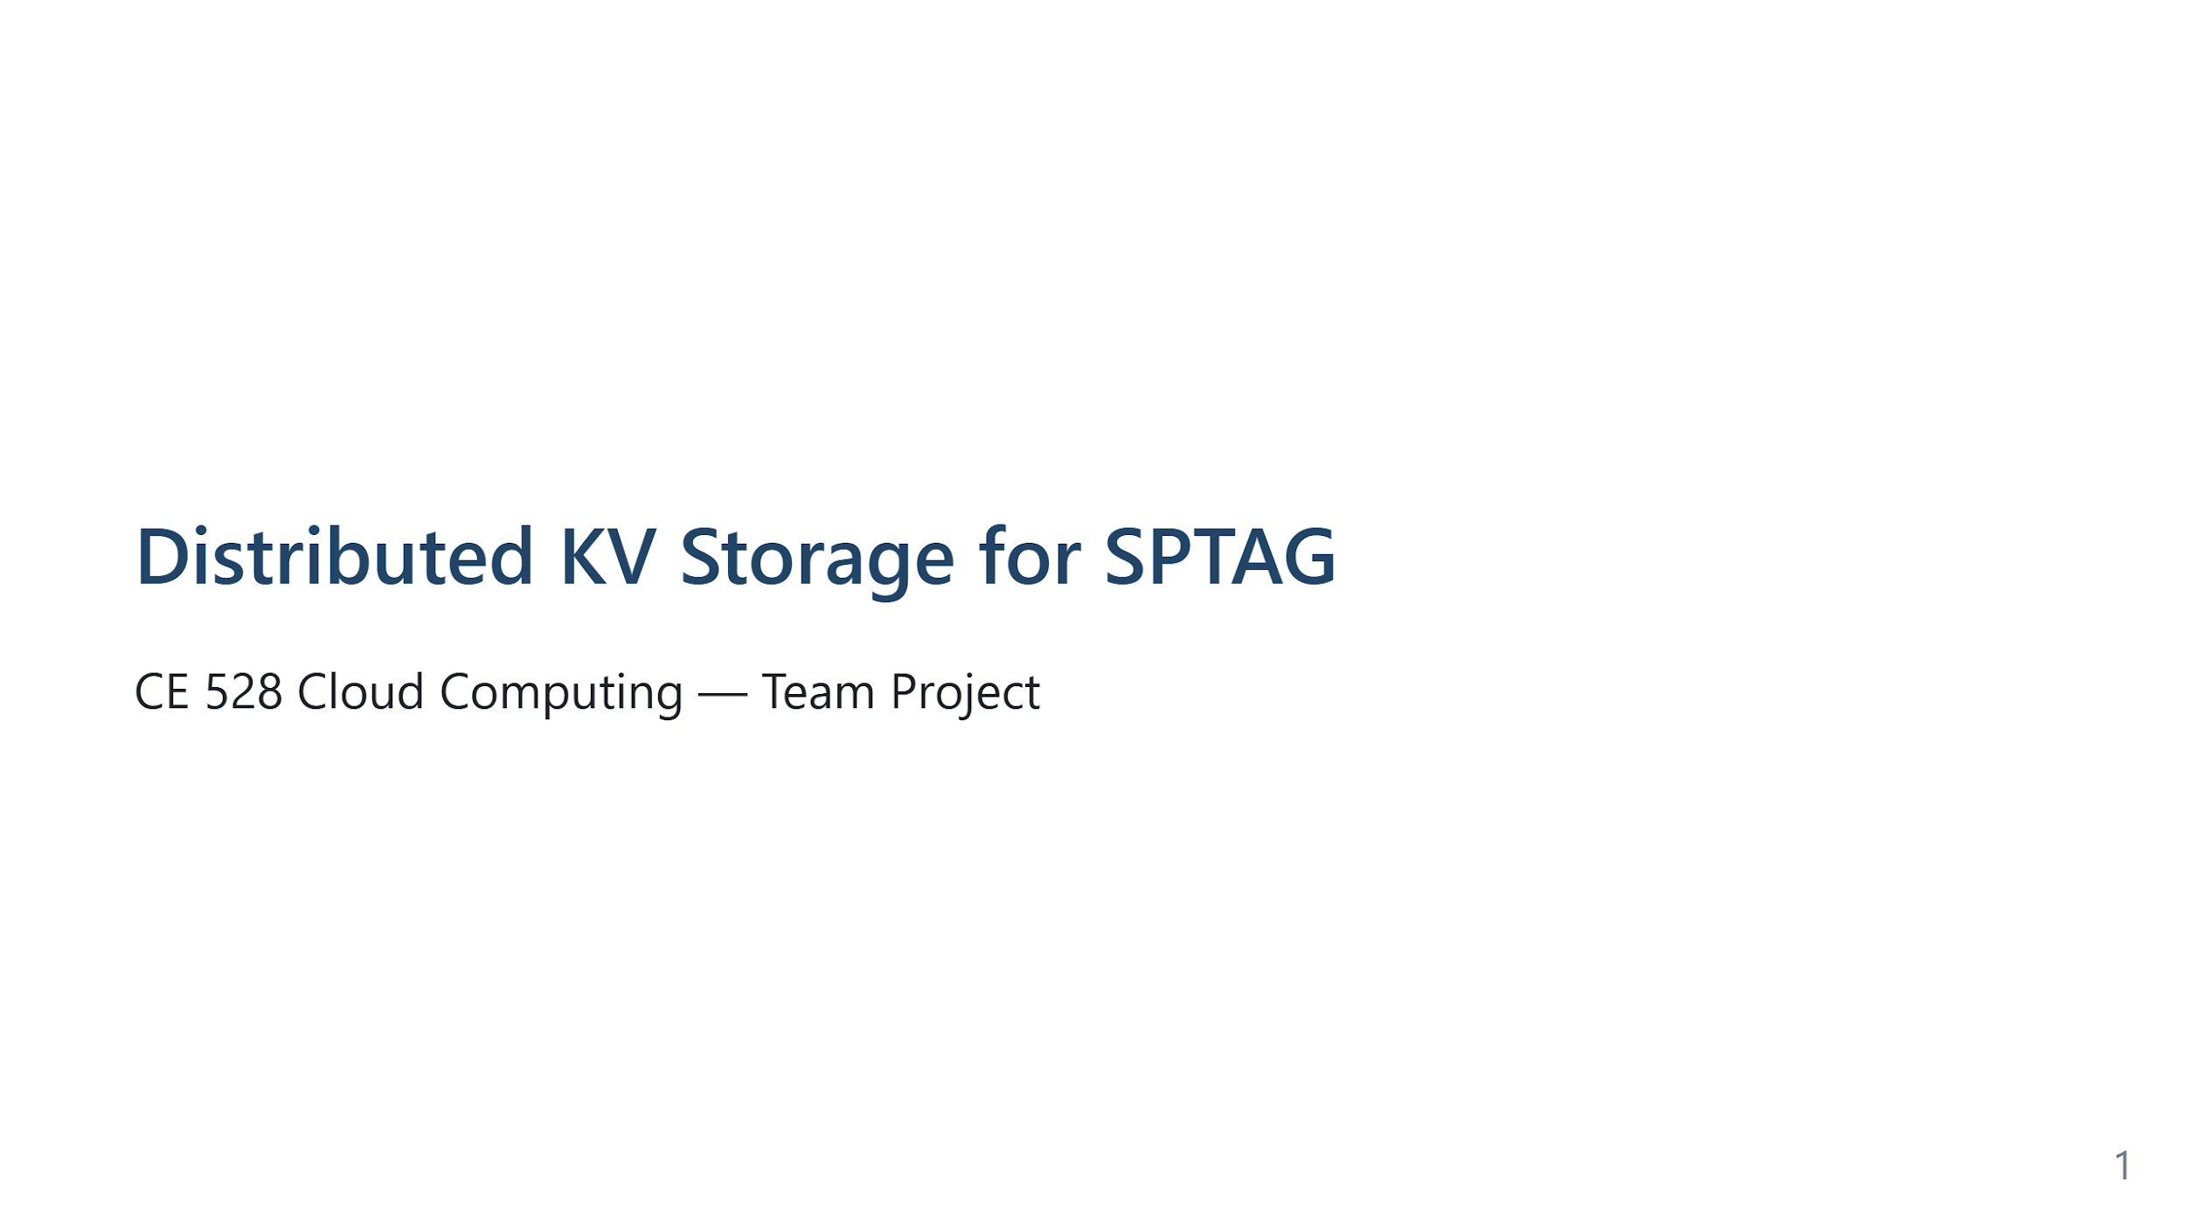

Slide 2
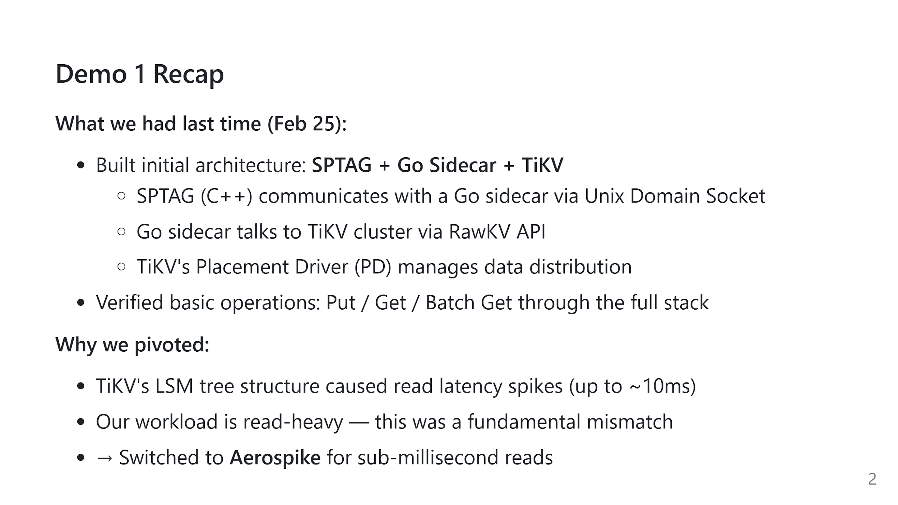
Notes:
Speaker notes: In Demo 1 we showed the initial architecture: SPTAG talking to TiKV through a Go sidecar. We got the basic pipeline working — Put, Get, and Batch Get all verified end-to-end. But we hit a wall: TiKV's design is optimized for writes, not reads. Because RAG retrieval is almost entirely reads, we needed something better. That's why we switched to Aerospike, which we'll explain in detail today. Mentoner want us to pivot.!

Slide 3
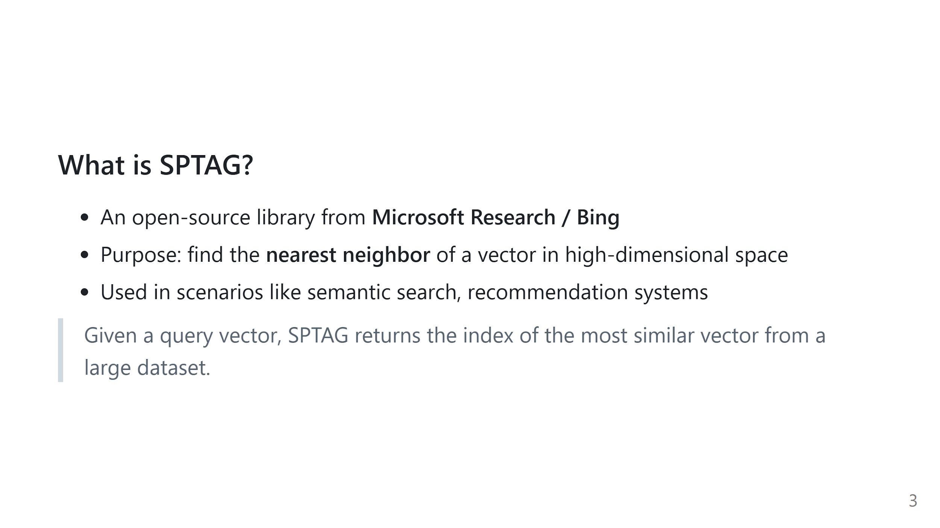
Notes:
Speaker notes: Quick refresher from last time — SPTAG is the vector search engine we're building on top of. It takes a query vector and finds the most similar one from a large dataset. We covered this in depth last demo, so let's move quickly.

Slide 4
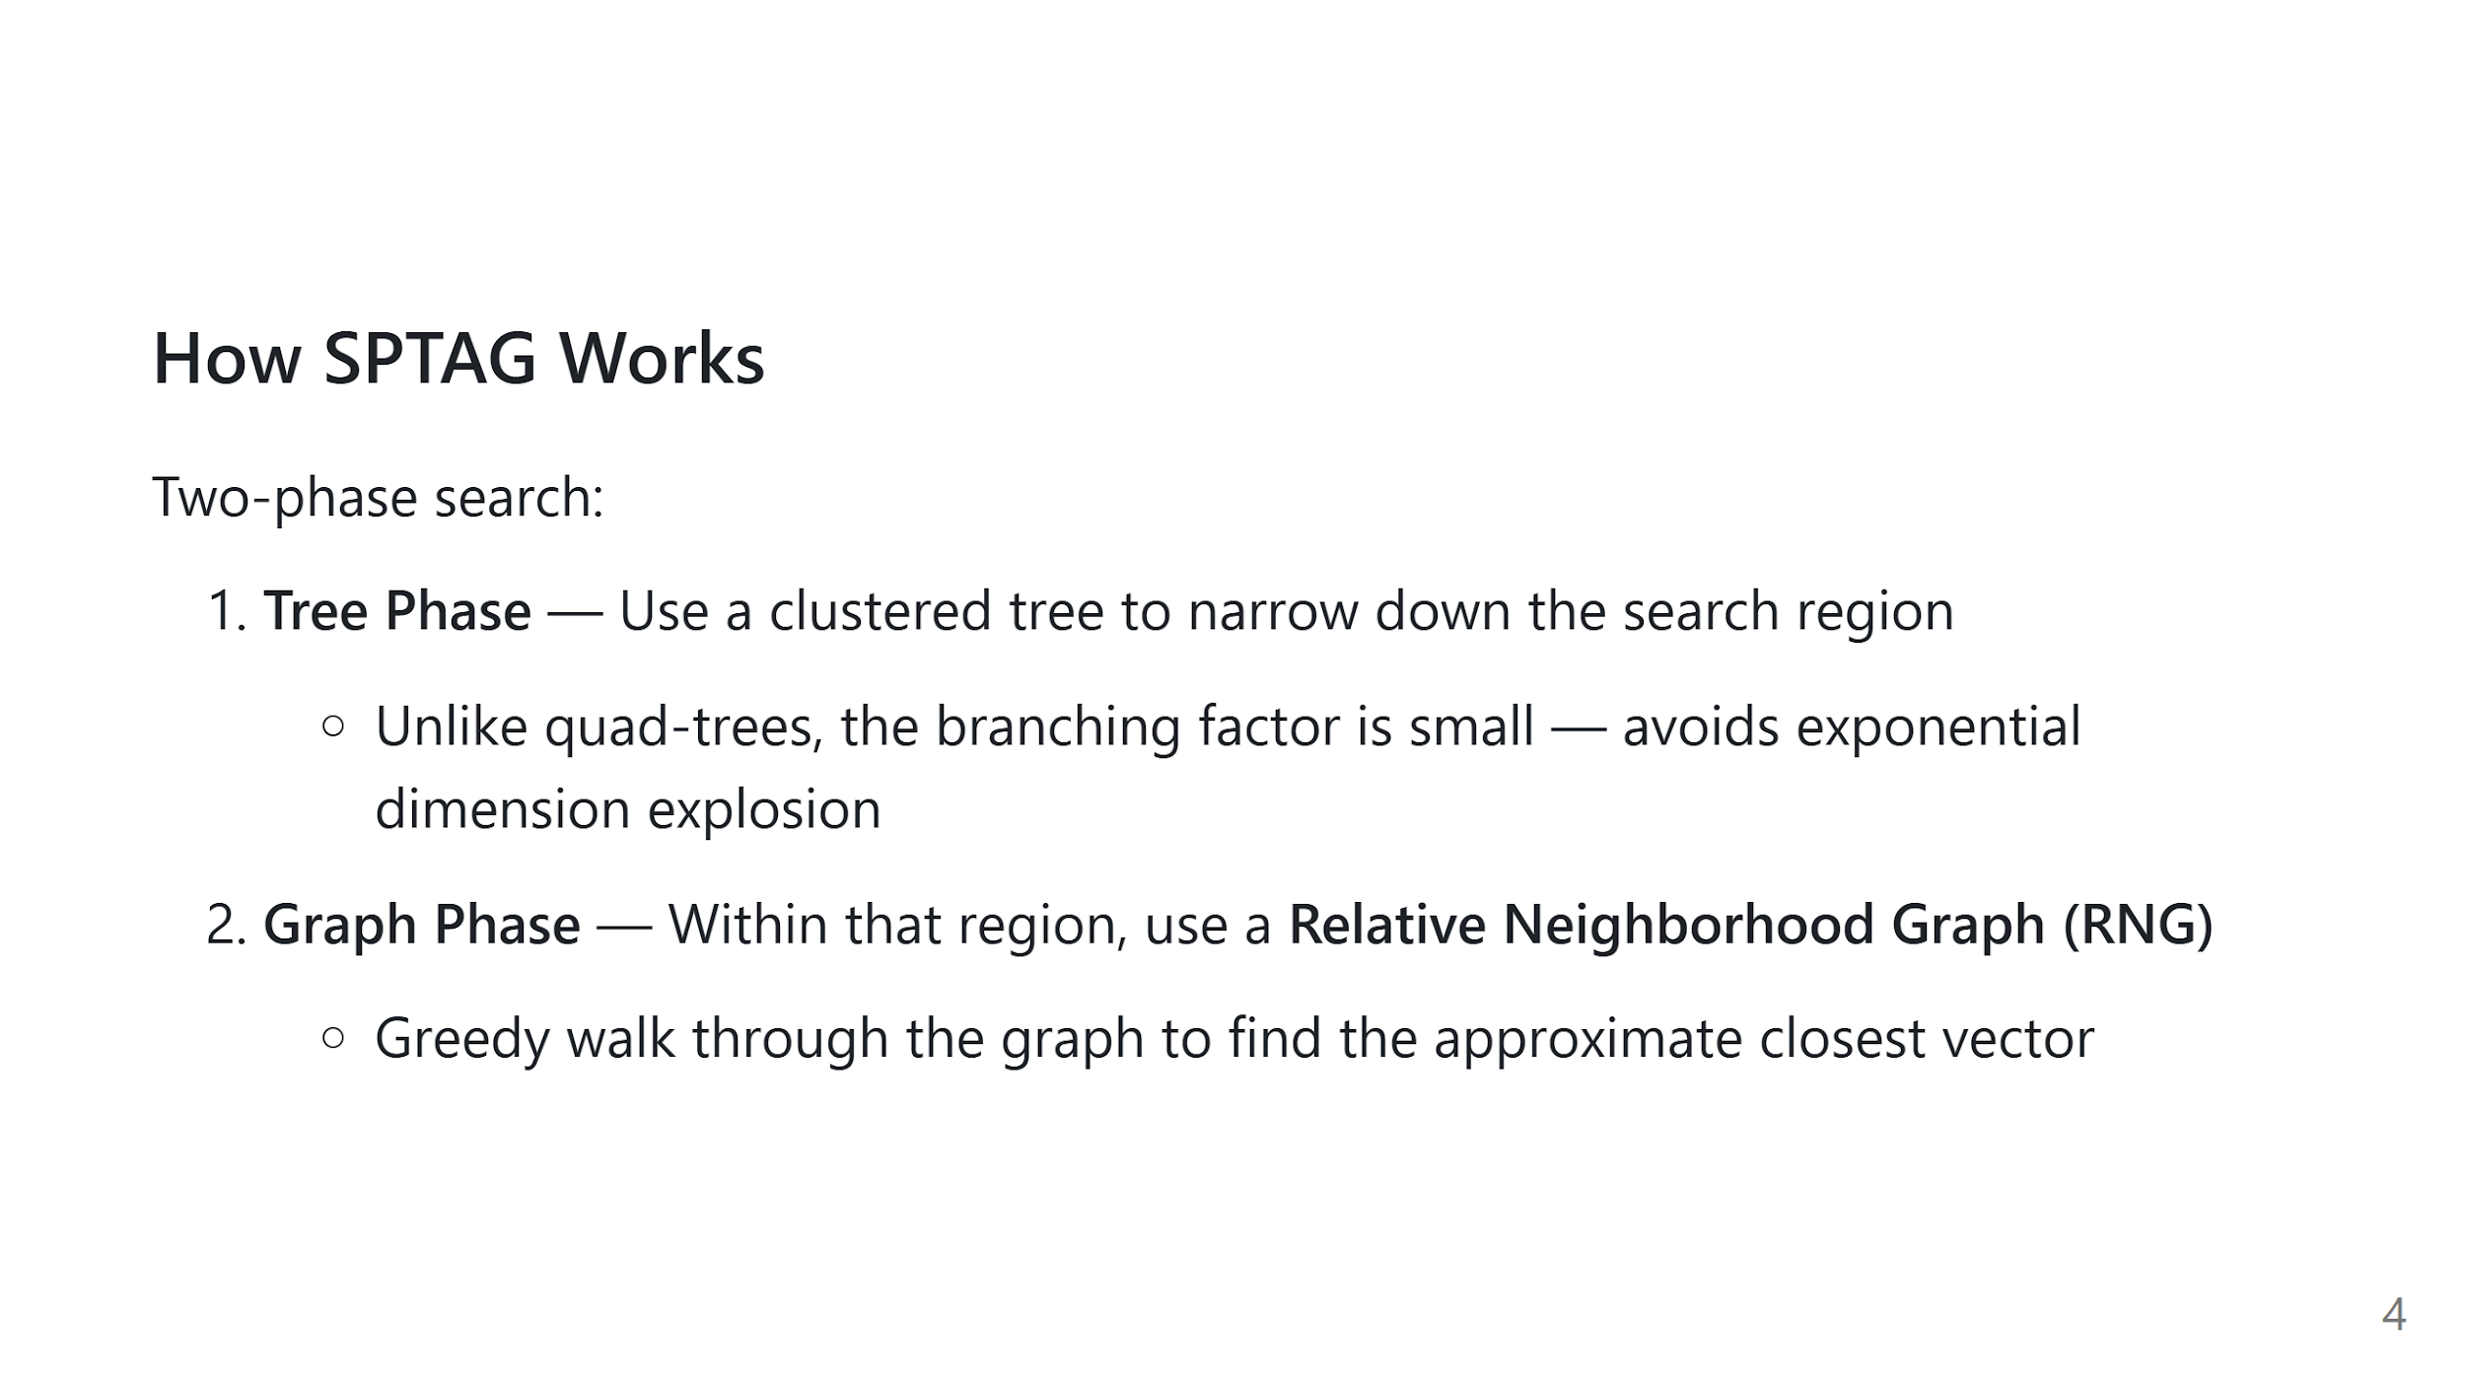
Notes:
Speaker notes: Again, just a recap — SPTAG first uses a clustered tree to zoom into the right region, then does a greedy graph walk to find the closest vector. The key point is it avoids the dimensionality explosion that traditional tree methods suffer from. We'll move on — the new stuff starts on the next slide.

Slide 5
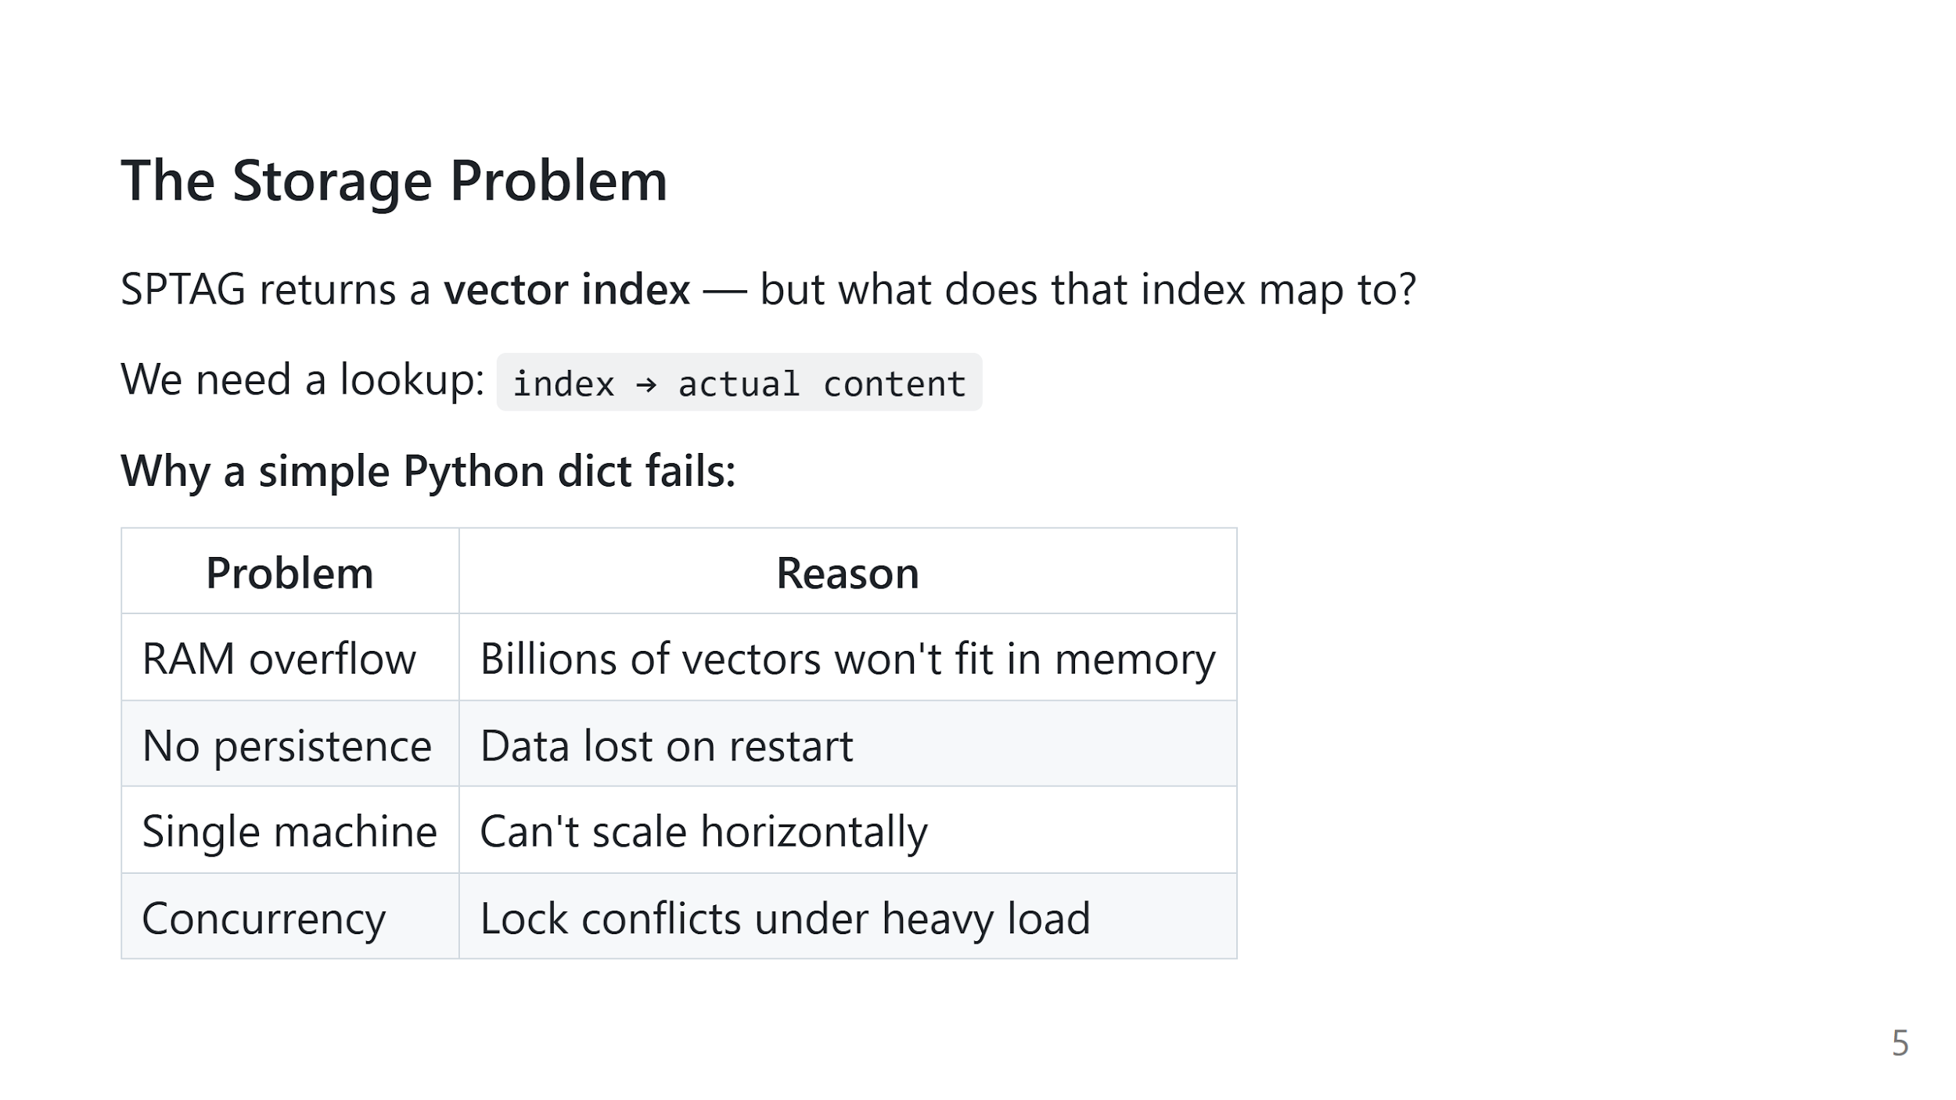
Notes:
Speaker notes: SPTAG tells you "the nearest neighbor is in vector at index 4,829,201" — but you still need to retrieve what that index actually represents. A dict in Python seems obvious, but it breaks down immediately at scale: - The dataset is too large for RAM - It vanishes when the server restarts - You can't split it across machines easily - Concurrent reads and writes cause lock contention We need a proper distributed storage backend.

Slide 6
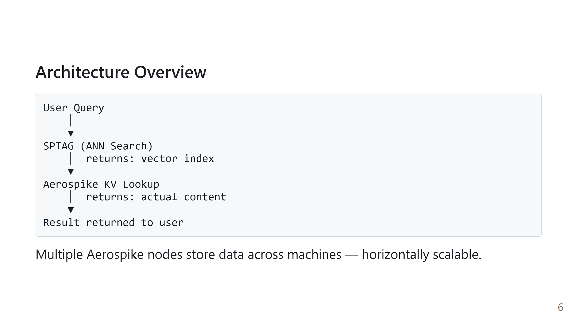
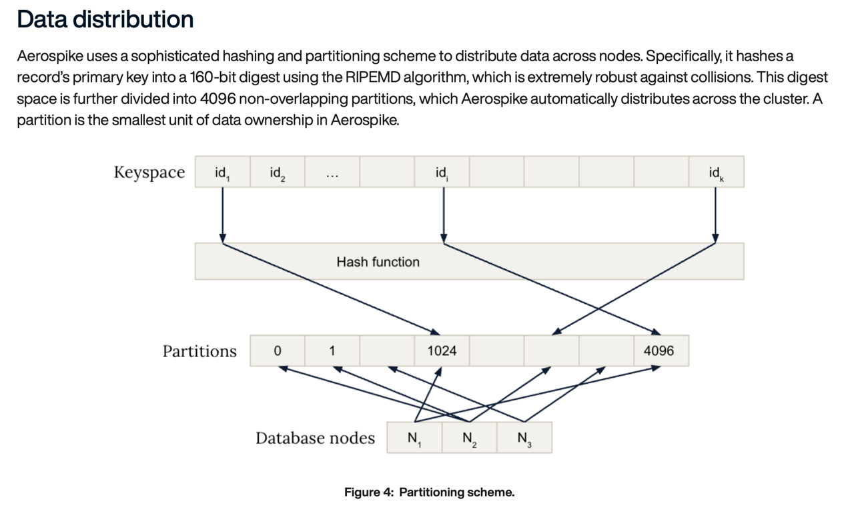
Notes:
Speaker notes: Here's the full pipeline: 1. A user submits a query vector 2. SPTAG finds the approximate nearest neighbor and returns its index 3. We pass that index to Aerospike, which looks up the actual content stored on disk 4. The result is returned to the user Aerospike runs across multiple machines, so the dataset can grow beyond what any single server can store. On the right Aerospike data distribution is shows – each key is uniformly hashed to one of 4096 partitions, and each partition is distributed across the cluster. Partition is the smallest unit of data ownership.

Slide 7
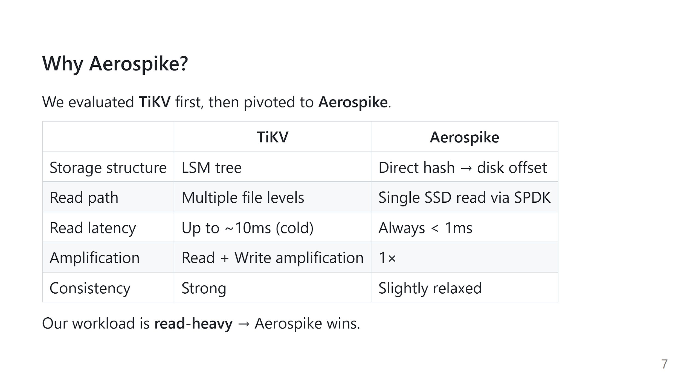
Notes:
Speaker notes: TiKV uses a Log-Structured Merge tree, which is great for writes but adds multiple levels of indirection for reads. If the data isn't in the block cache (RAM), TiKV has to search through multiple disk files — causing latency spikes up to 10ms. Aerospike takes a completely different approach: - Each hash index directly stores the SSD offset - It uses SPDK to bypass the OS kernel and read the SSD directly - This gives consistent sub-millisecond reads For an ANN search system, every lookup happens after SPTAG runs — it's pure read traffic. That's why Aerospike is the better fit here.

Slide 8
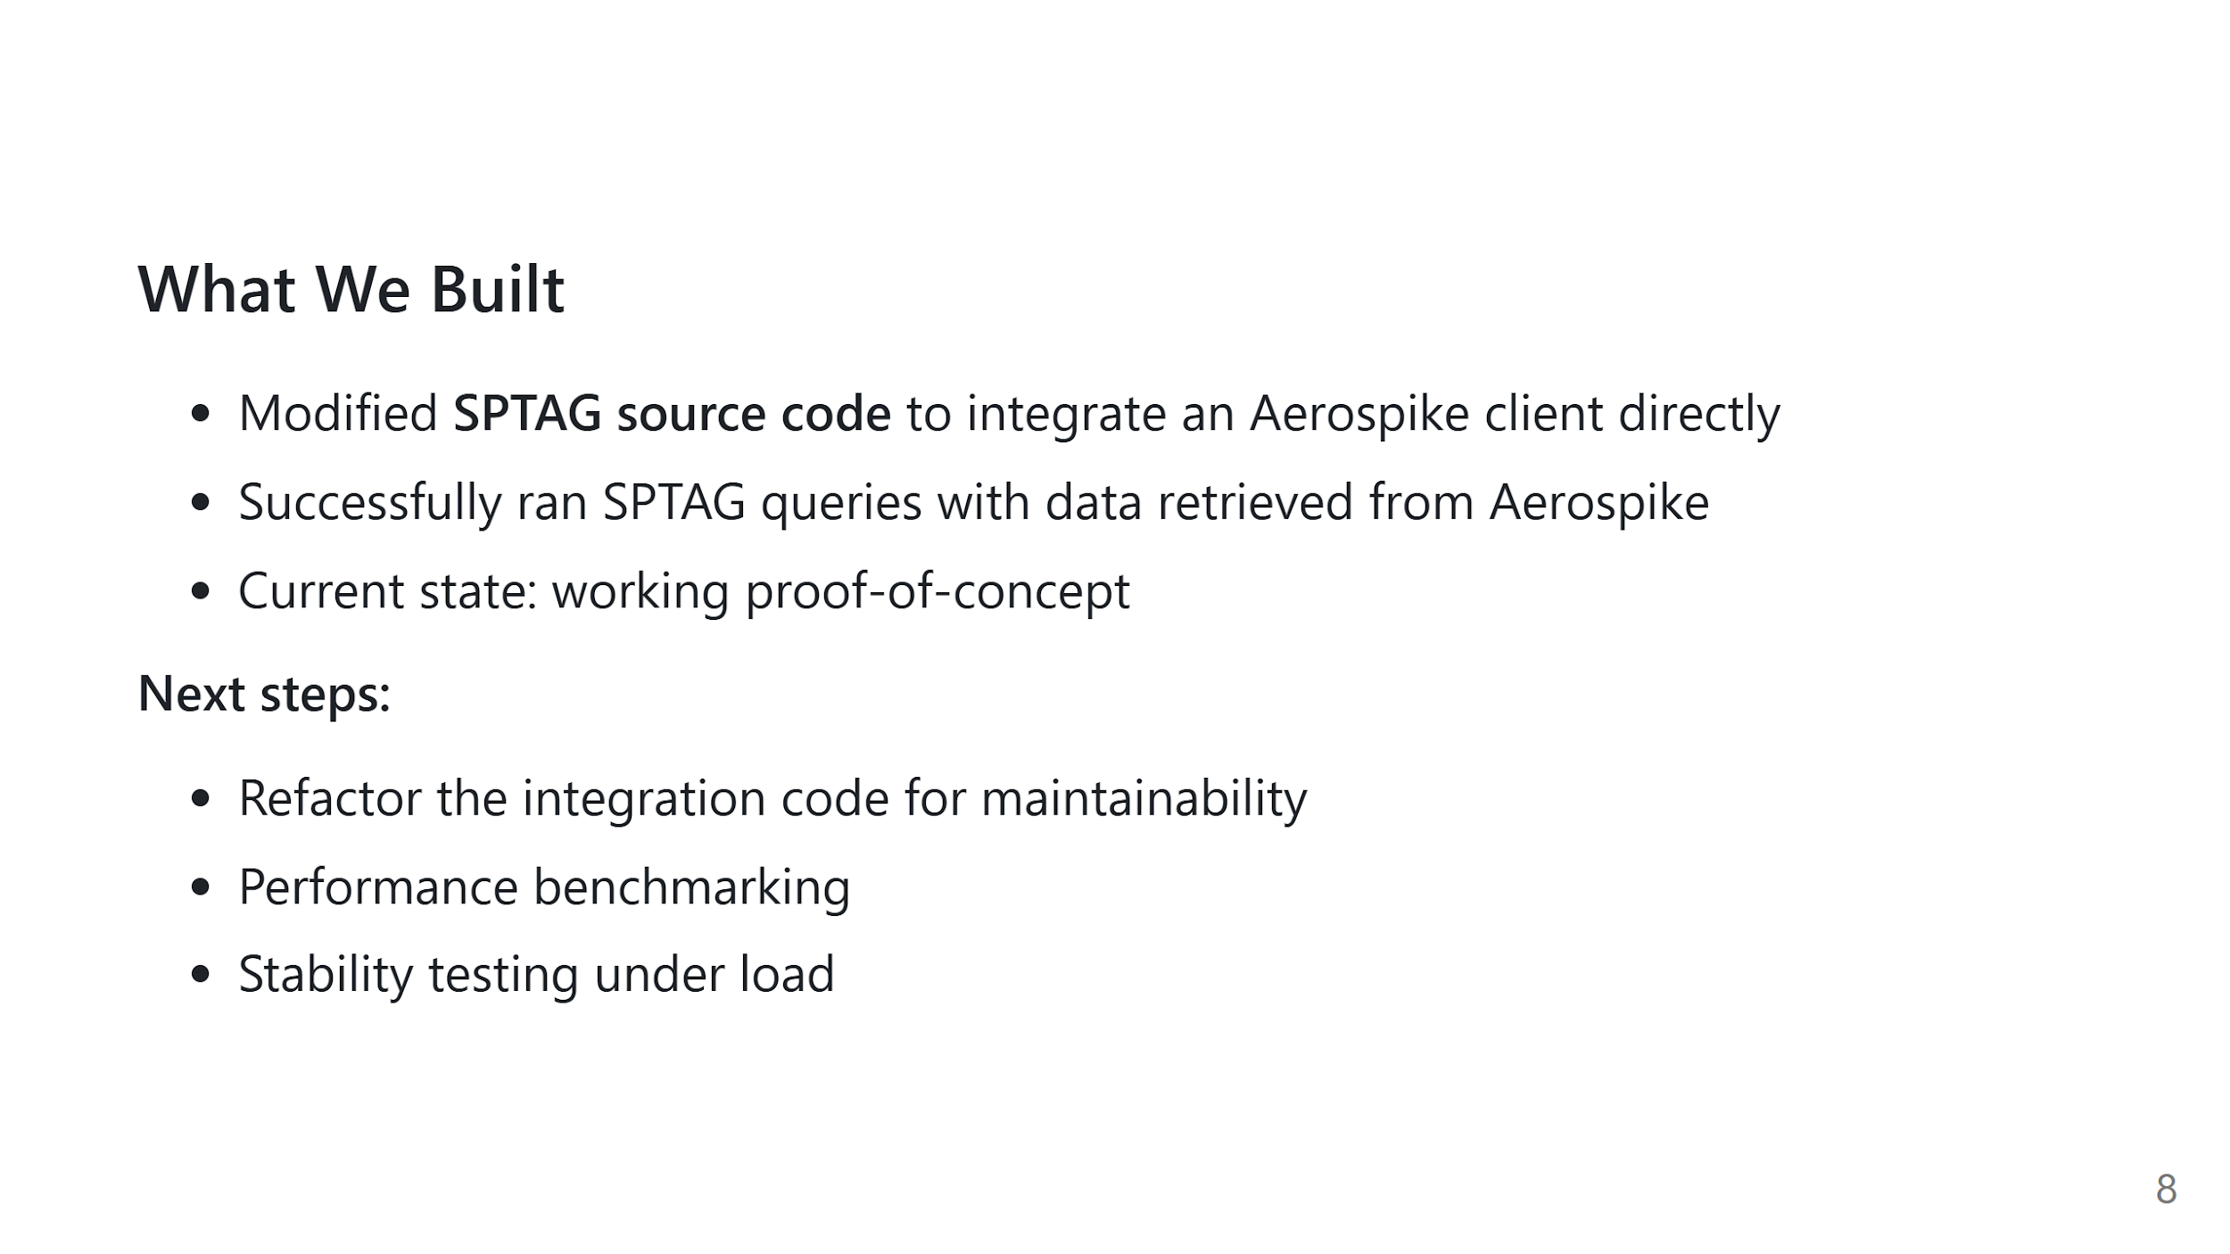
Notes:
Speaker notes: We directly modified the SPTAG C++ source code to add Aerospike client calls at the retrieval layer. The system runs end-to-end: a query goes in, SPTAG finds the nearest neighbor, Aerospike fetches the content, and we get the result. It's currently a proof-of-concept — the integration works but the code needs cleanup. Our next focus is refactoring, then benchmarking to measure actual latency improvements.

Slide 9
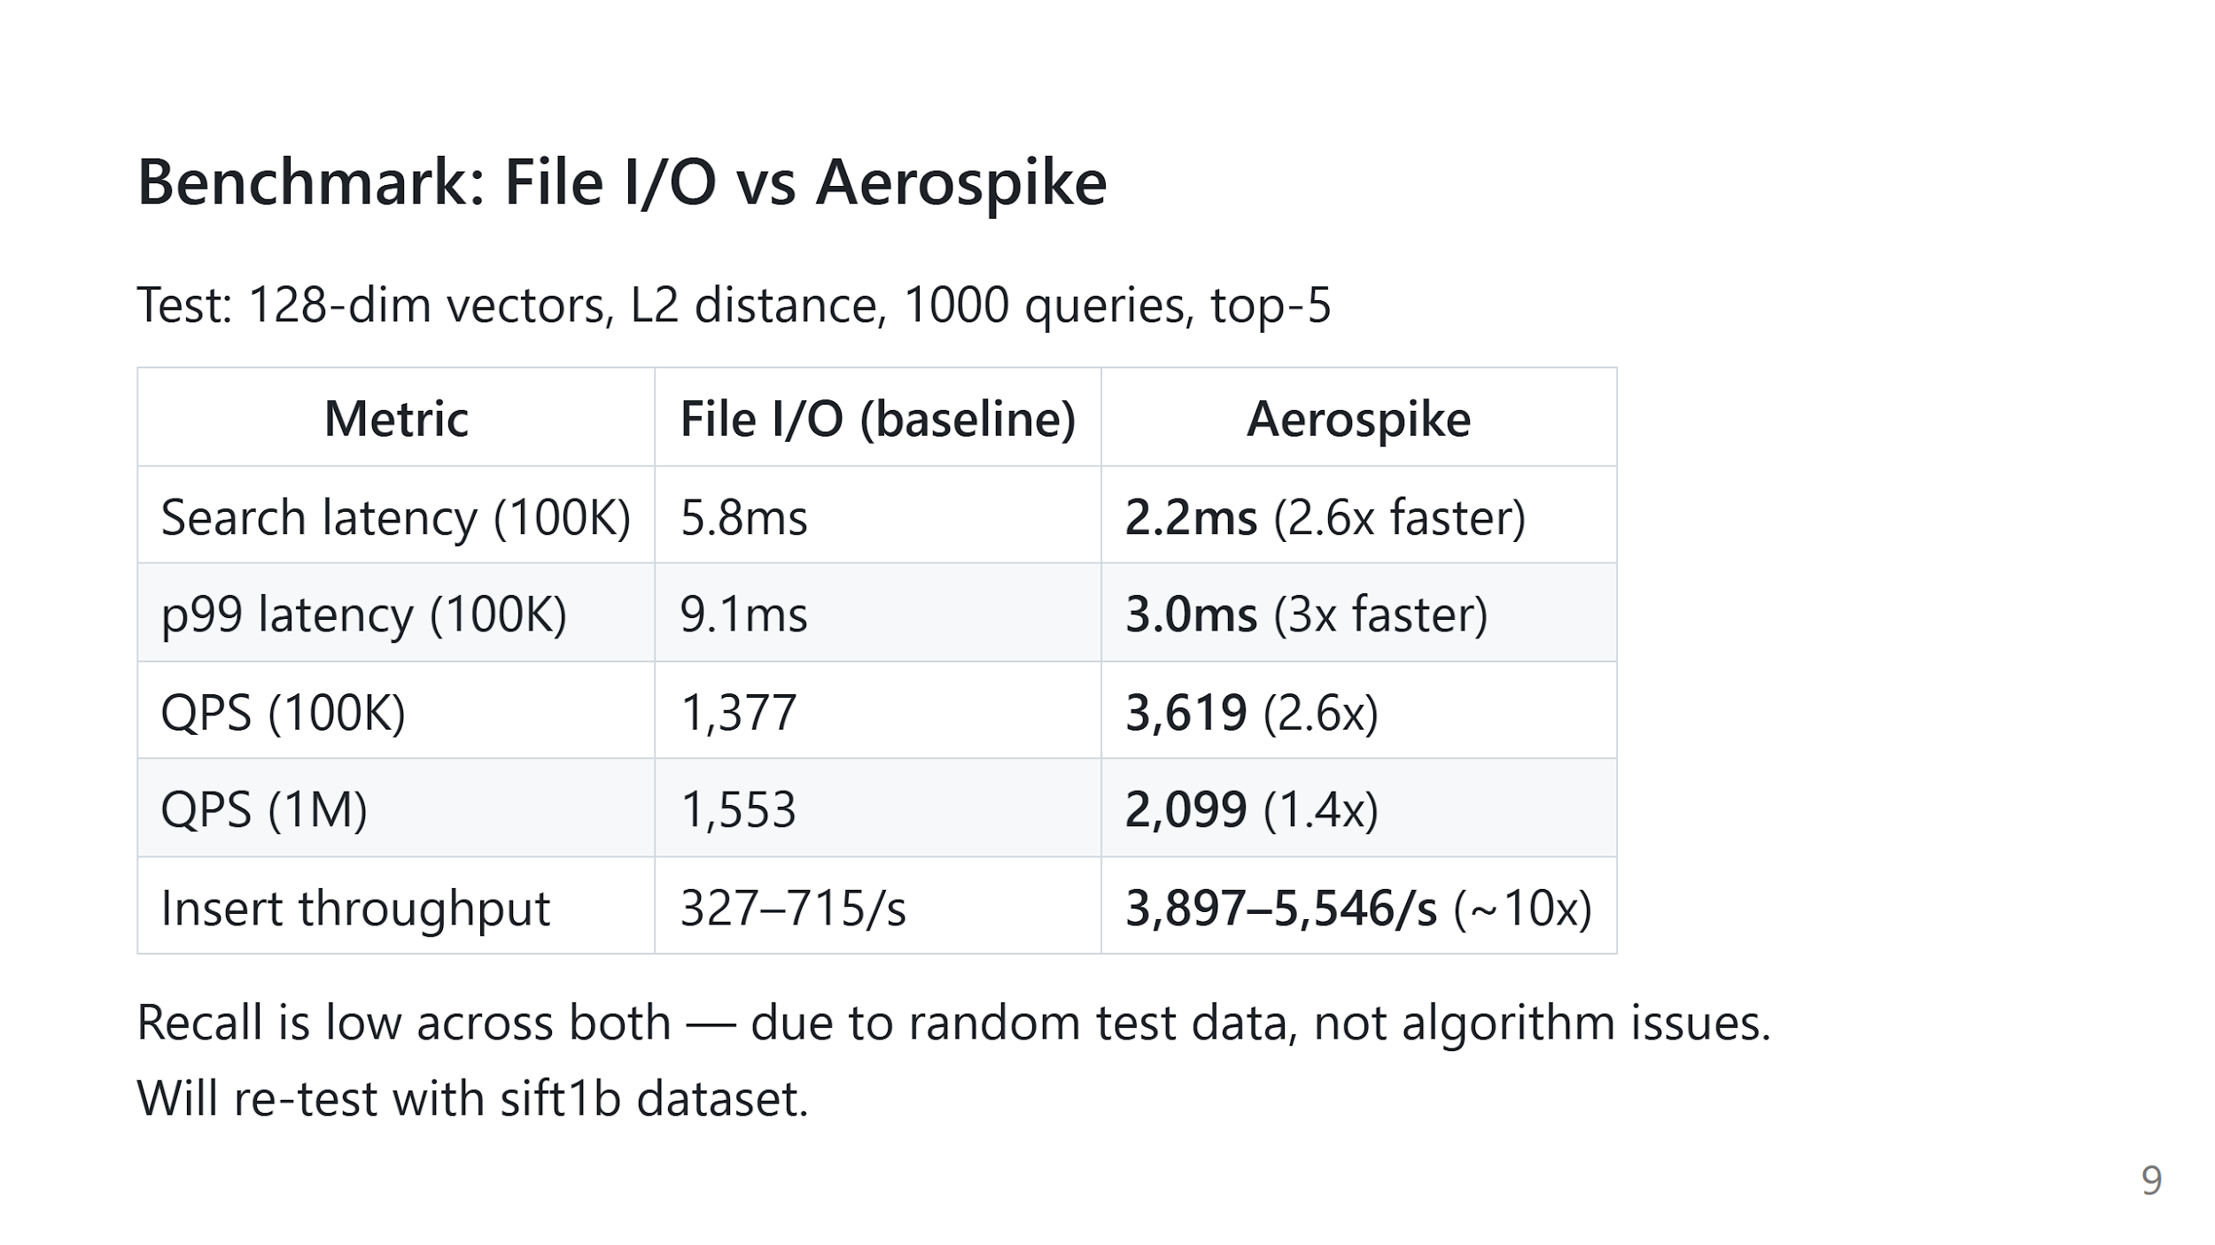
Notes:
Speaker notes: We ran the same benchmark twice — once with SPTAG reading from local files, once reading from Aerospike. Same data, same queries. Aerospike cuts search latency roughly in half, handles over twice the queries per second, and inserts about 10 times faster. You'll notice recall is low in both cases. That's not an Aerospike problem — it's because our test data is randomly generated. The vectors are all roughly the same distance apart, so SPTAG can't easily tell which ones are actually closest. Our mentor confirmed this is expected. We plan to re-run with sift1b, which is a standard benchmark dataset with more realistic structure.

Slide 10
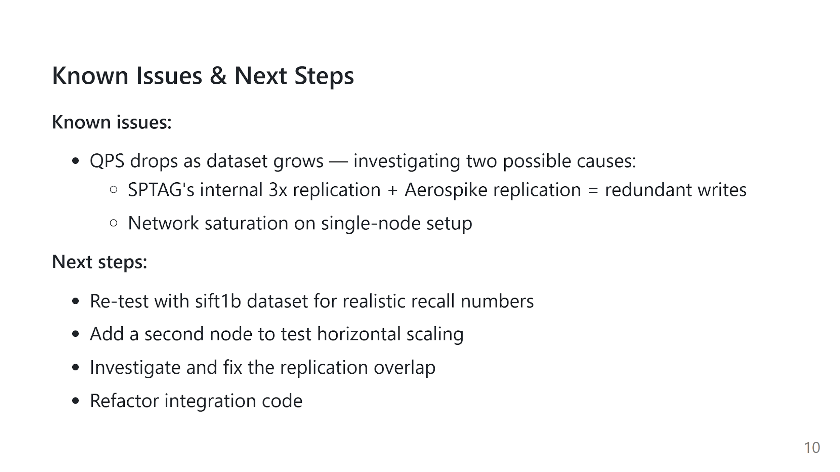
Notes:
Speaker notes: Aerospike’s QPS drops as the dataset grows drastically. We think the main reason is a double-replication problem. Here's what's happening: SPTAG internally stores 3 copies of the same vector. When we write to Aerospike, it doesn't know these are duplicates — it treats each copy as a separate piece of data and replicates all of them again. So one vector ends up being written many more times than it should be, and that extra write load drags down QPS. The other possibility is that we're running everything on a single machine, so the network connection on that one machine might be the bottleneck. We plan to add a second machine and fix the duplicate replication issue.

Slide 11
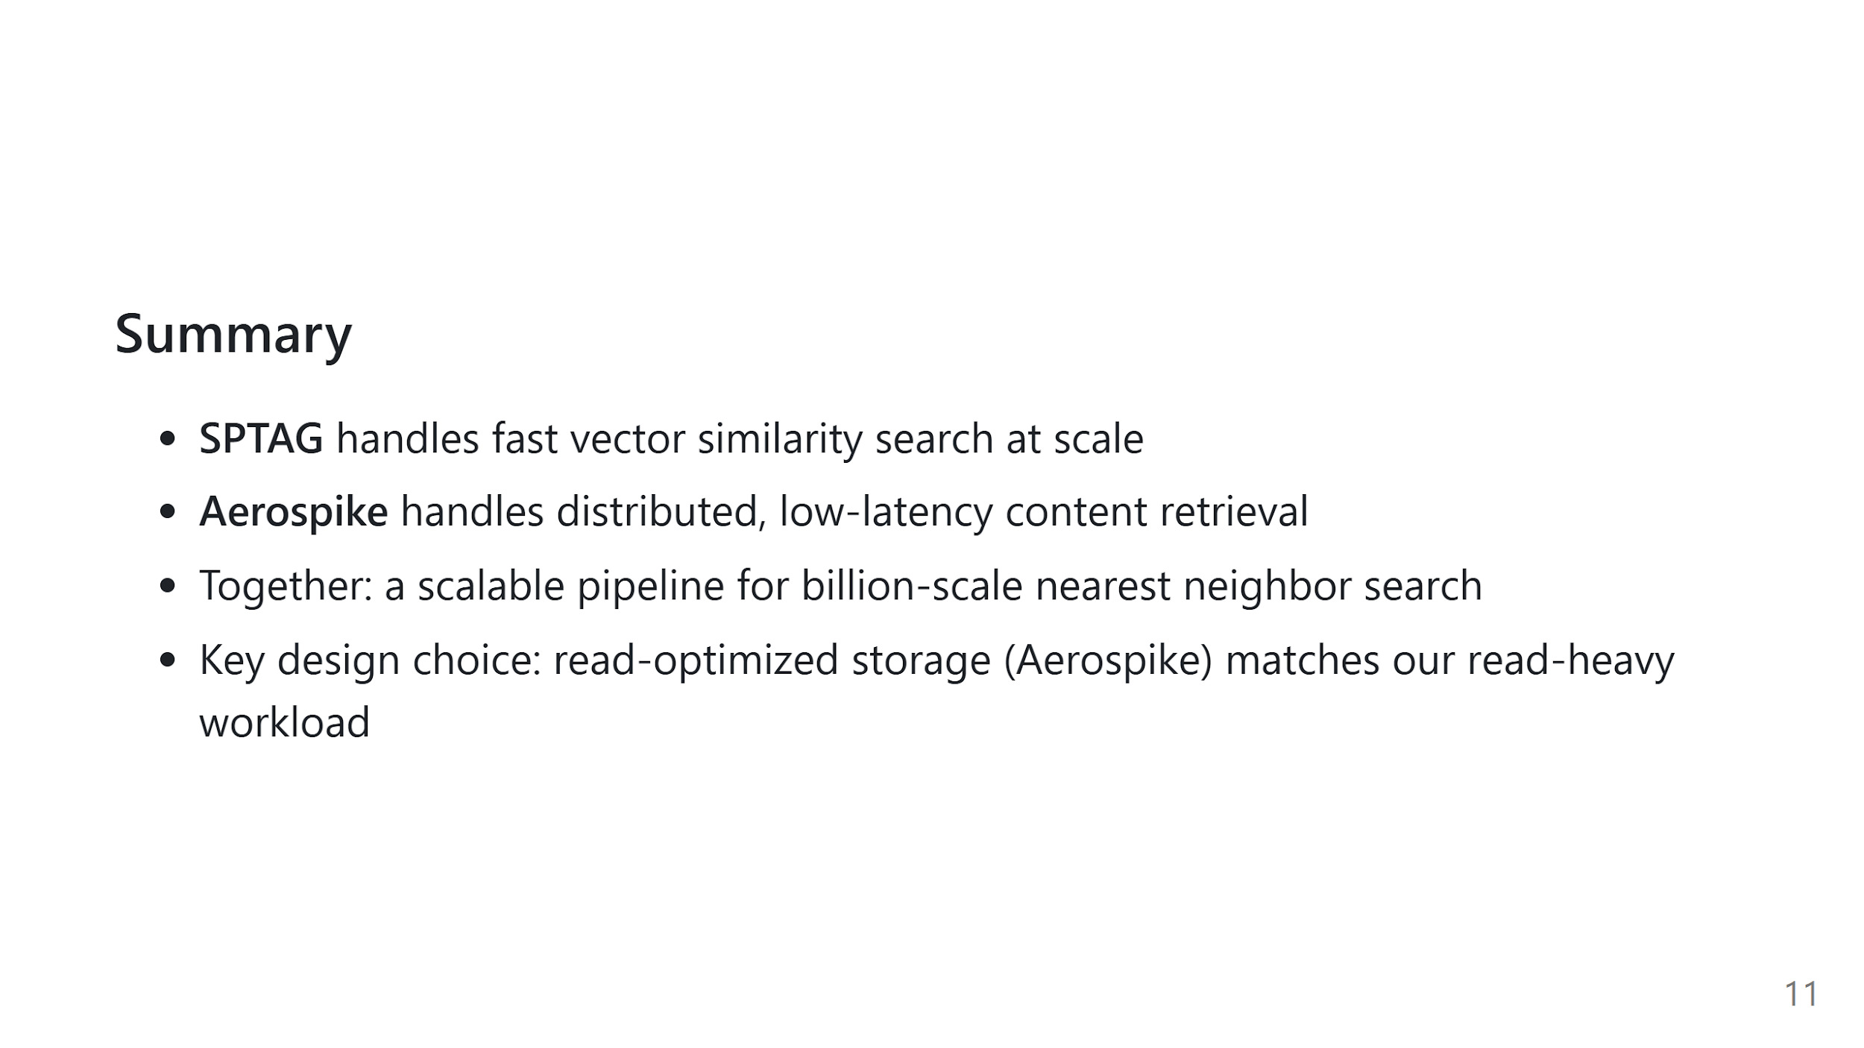
Notes:
Speaker notes: To wrap up: SPTAG solves the search problem efficiently by combining trees and graphs. Aerospike solves the storage problem by providing fast, distributed, persistent key-value lookup. The two systems complement each other — SPTAG is our index, Aerospike is our database. The main architectural decision was choosing a read-optimized storage backend to match how SPTAG is actually used. Thank you.

